Slide 1

Department of Artificial Intelligence and Data Science
DSA0404-Fundamentals of Data Science
An Exploratory Data Analytics Framework for Understanding Diabetes Risk Factors Using Healthcare and Lifestyle Data
Submitted By:
T Megha Harsha (192424389)
B C Yugesh (192424282)

Slide 2


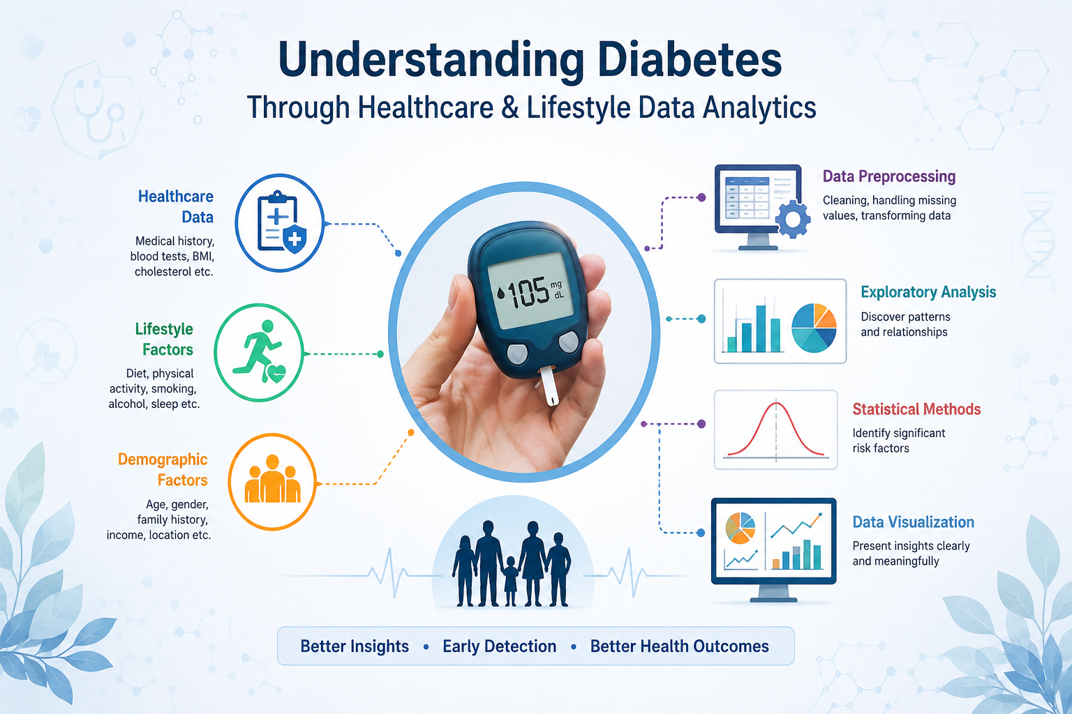
Introduction
Diabetes is a common health condition influenced by healthcare, lifestyle, and demographic factors.
Data analytics helps identify patterns and relationships between diabetes and different risk factors.
This project uses healthcare, lifestyle, and demographic data to understand diabetes-related patterns.
Data preprocessing and exploratory data analysis are used to clean the dataset and discover meaningful trends.
Statistical analysis and data visualization are used to present important findings clearly and support better health awareness.

Slide 3
Objectives
To analyze healthcare and lifestyle data using exploratory data analytics to identify important factors and patterns associated with diabetes.
Clean and prepare the healthcare dataset.
Understand the distribution of patient health information.
Identify important diabetes-related factors.
Analyze relationships between different variables.
Visualize patterns using suitable graphs and charts.

Slide 4
SDG Mapping
Good Health and Well-being: Supports better understanding of diabetes risk factors.
Early Risk Identification: Helps identify factors related to diabetes at an early stage.
Health Awareness: Provides insights into lifestyle factors affecting health.
Data-Driven Healthcare: Encourages the use of data for healthcare analysis and decision-making.
Preventive Health: Supports awareness of healthier lifestyle choices and diabetes prevention.

Slide 5
Literature Review
Author(s) & Year | Method/Algorithm | Data Used | Key Findings
Saeedi et al. (2023) | Descriptive Statistics, Epidemiological Analysis | Global diabetes and health data | Reported the increasing prevalence of diabetes and highlighted the importance of understanding demographic and health-related risk factors.
Zhou et al. (2023) | Exploratory Data Analysis, Statistical Analysis | Diabetes and healthcare data | Identified relationships between diabetes and factors such as age, BMI, glucose level, and blood pressure.
Kumar et al. (2024) | Data Preprocessing, Descriptive Statistics, Correlation Analysis | Diabetes healthcare dataset | Showed that proper preprocessing and correlation analysis can reveal important relationships among clinical variables.
Patel et al. (2024) | EDA, Statistical Testing, Data Visualization | Healthcare and lifestyle data | Found that lifestyle and demographic factors can provide useful insights into diabetes risk patterns.
Sharma et al. (2025) | Exploratory Analysis, Statistical Methods, Visualization | Diabetes patient and lifestyle data | Demonstrated that combining healthcare and lifestyle variables provides a broader understanding of diabetes-related patterns.

Slide 6
Problem statement
Diabetes-related datasets contain many health and lifestyle attributes.
It is difficult to identify important patterns by manually examining large datasets.
Different factors may have different relationships with diabetes.
Missing and inconsistent data can affect the quality of analysis.
Without proper visualization, important patterns may be difficult to understand.

Slide 7
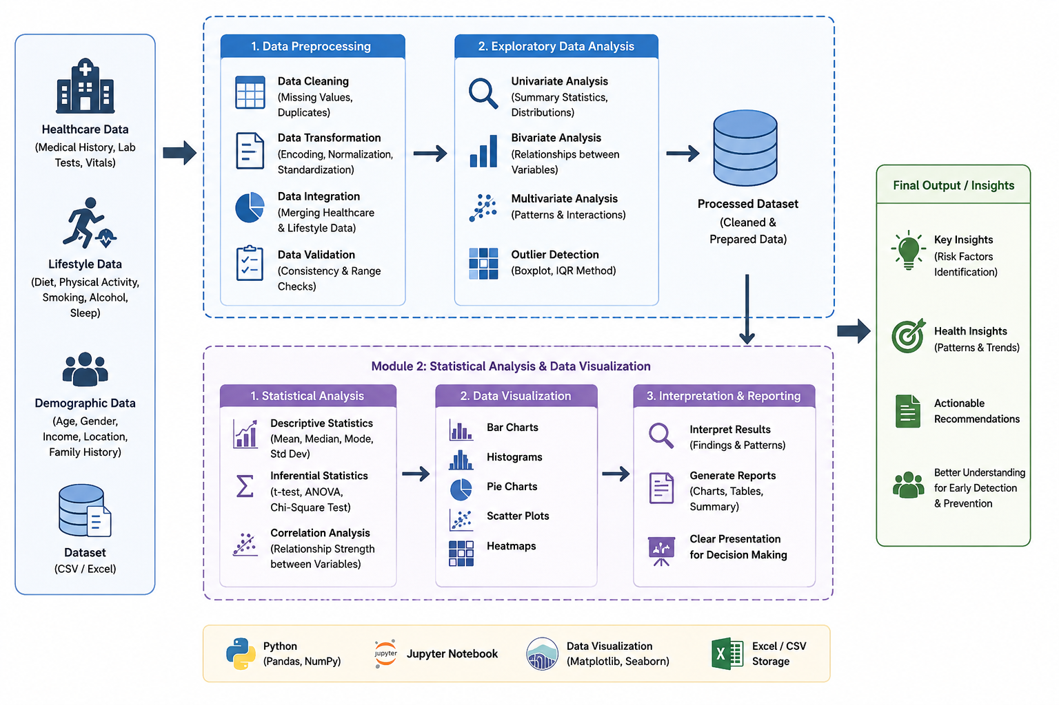

System Architecture

Slide 8
Module 1: Data Preprocessing & Exploratory Data Analysis
Collect the diabetes healthcare dataset.
Load the dataset using Python and Pandas.
Check missing values, duplicates, and incorrect data.
Perform data cleaning and preprocessing.
Calculate descriptive statistics such as mean, median, and standard deviation.
Analyze the distribution of important health and lifestyle factors.
Technologies:
Python, Pandas, NumPy

Slide 9
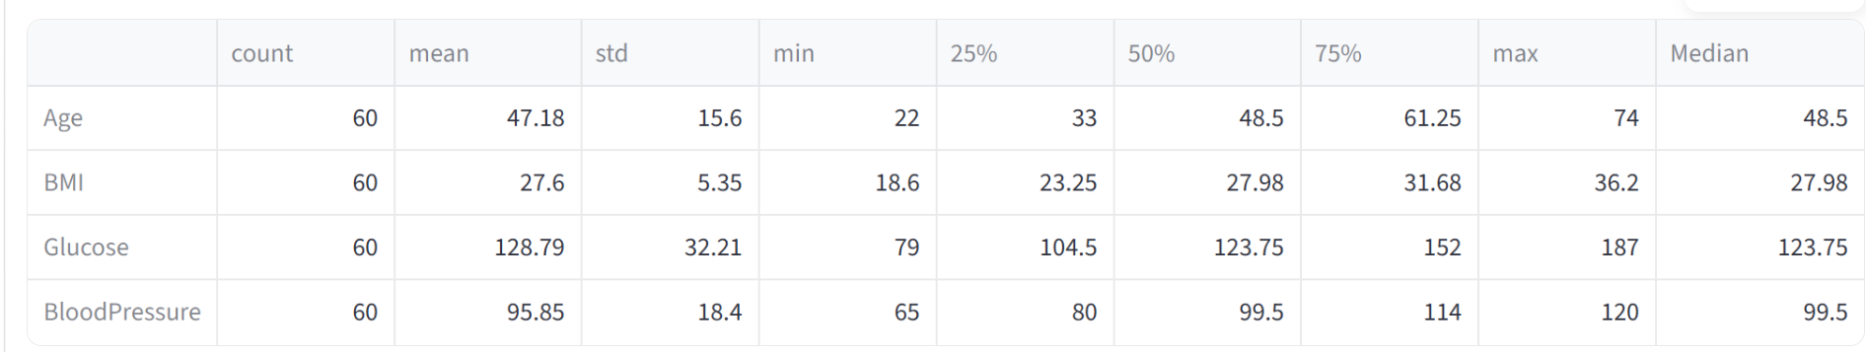
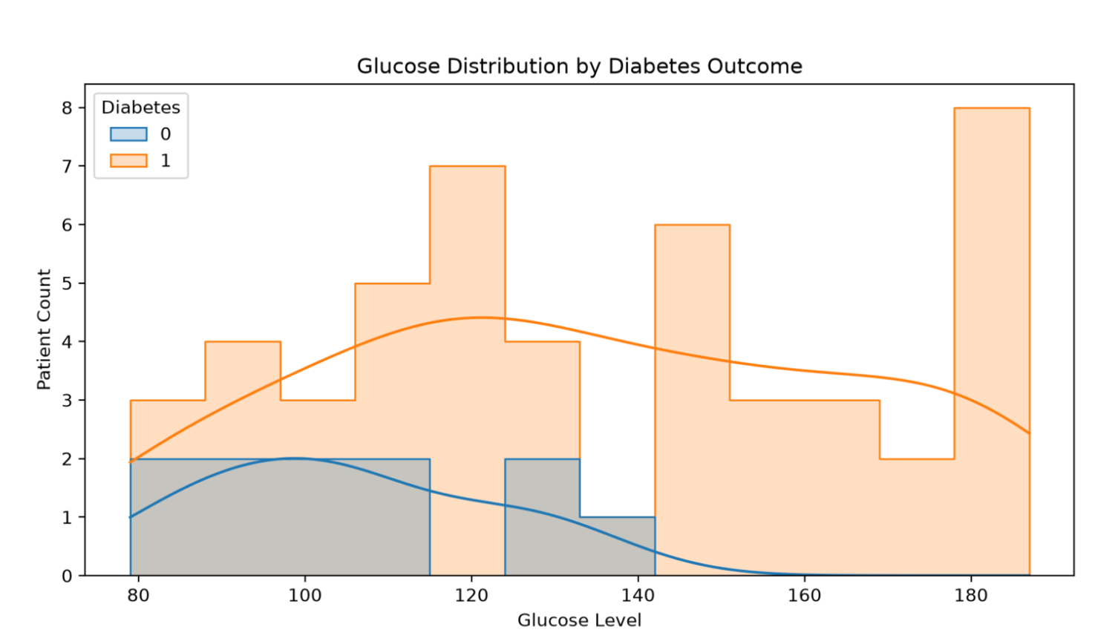
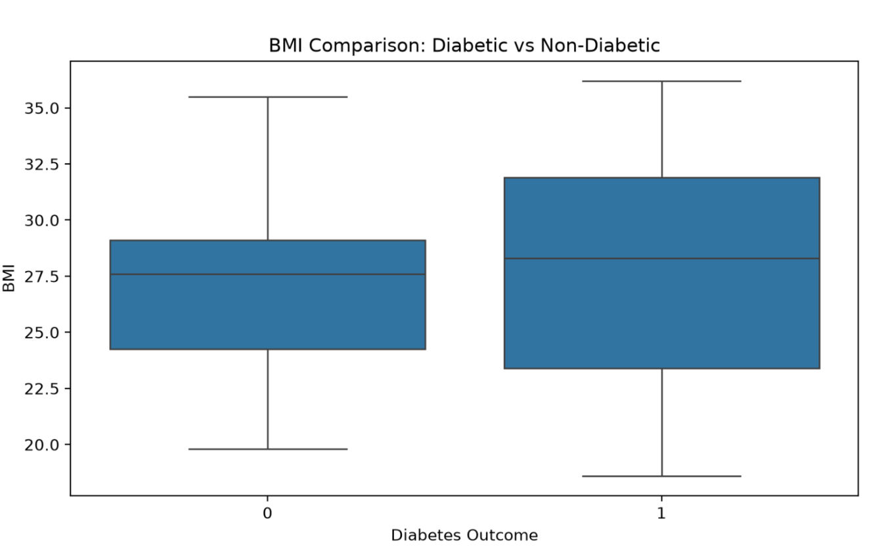
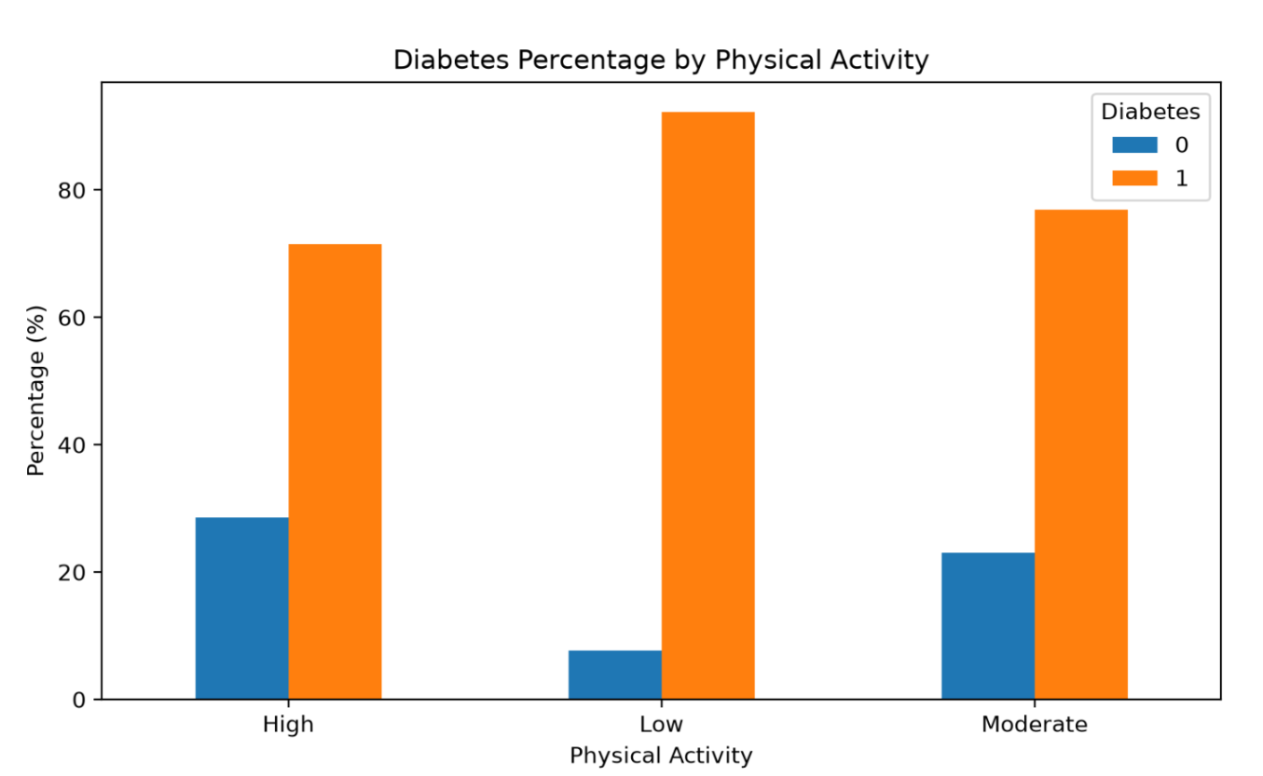
Output
Descriptive Statistics
Glucose Distribution
BMI Comparison
Physical Activity Analysis

Slide 10
Module 2: Statistical Analysis & Data Visualization
Analyze relationships between health factors and diabetes.
Perform correlation analysis between different variables.
Create charts such as bar charts, histograms, and box plots.
Create a correlation heatmap to identify strong relationships.
Compare diabetic and non-diabetic groups.
Generate meaningful insights and recommendations from the analysis.
Technologies:
Matplotlib, Seaborn, Pandas

Slide 11
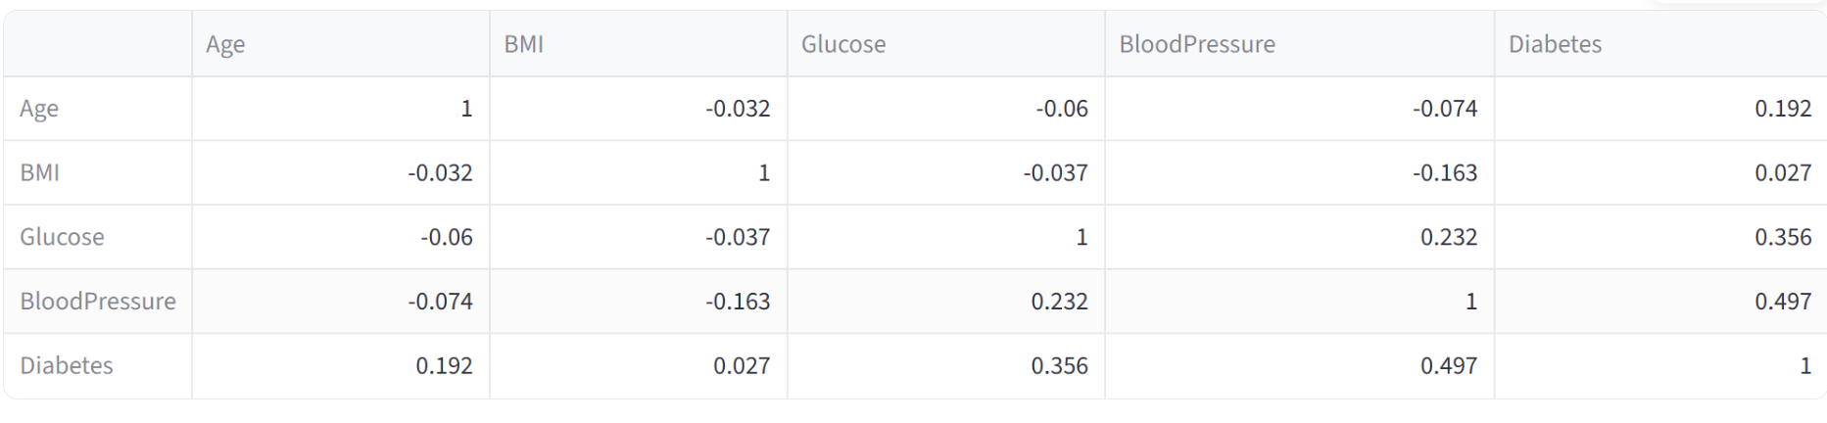
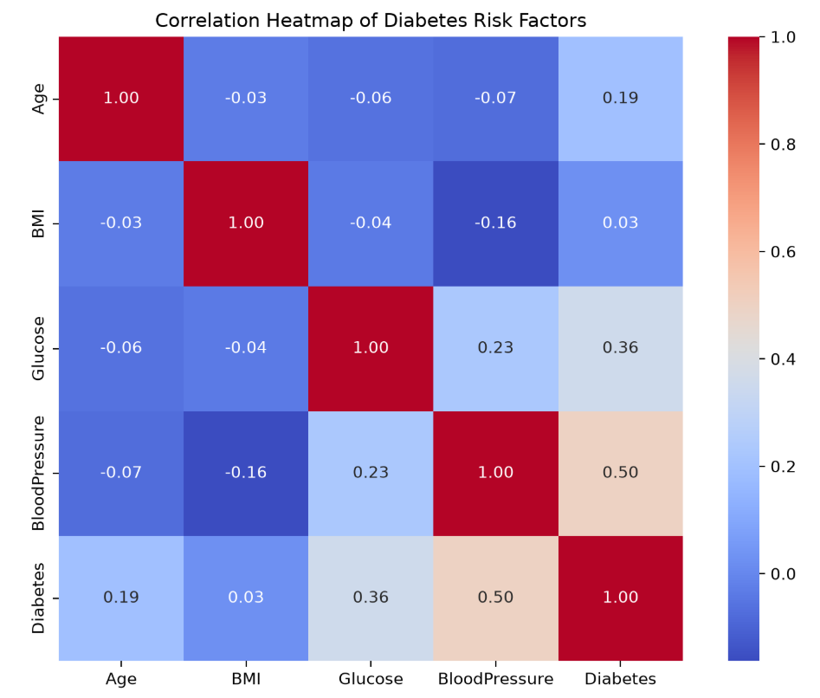
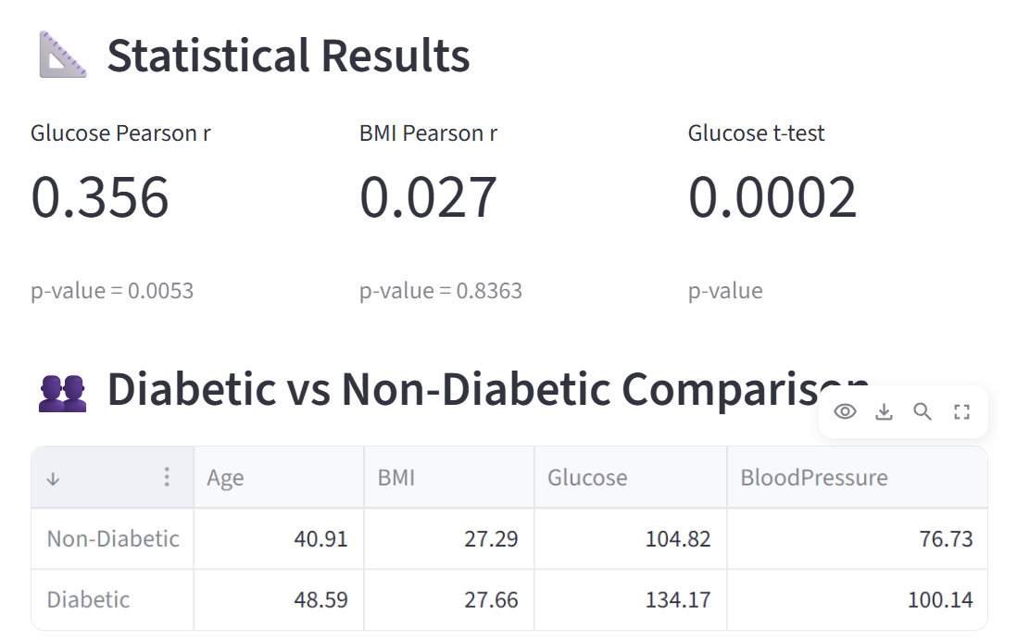
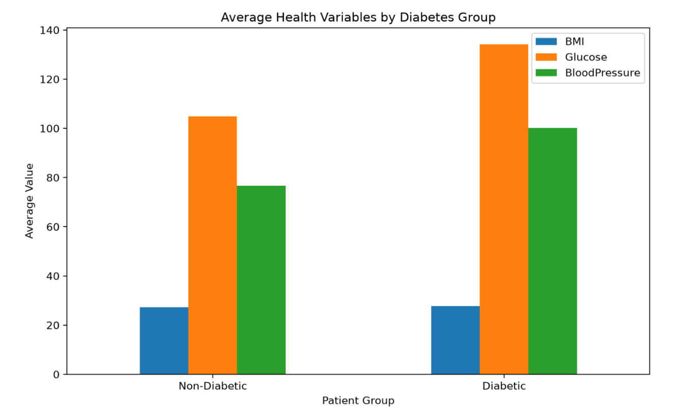
Output
Correlation Analysis
Correlation Heatmap
Average Health Variables by Diabetes Group

Slide 12
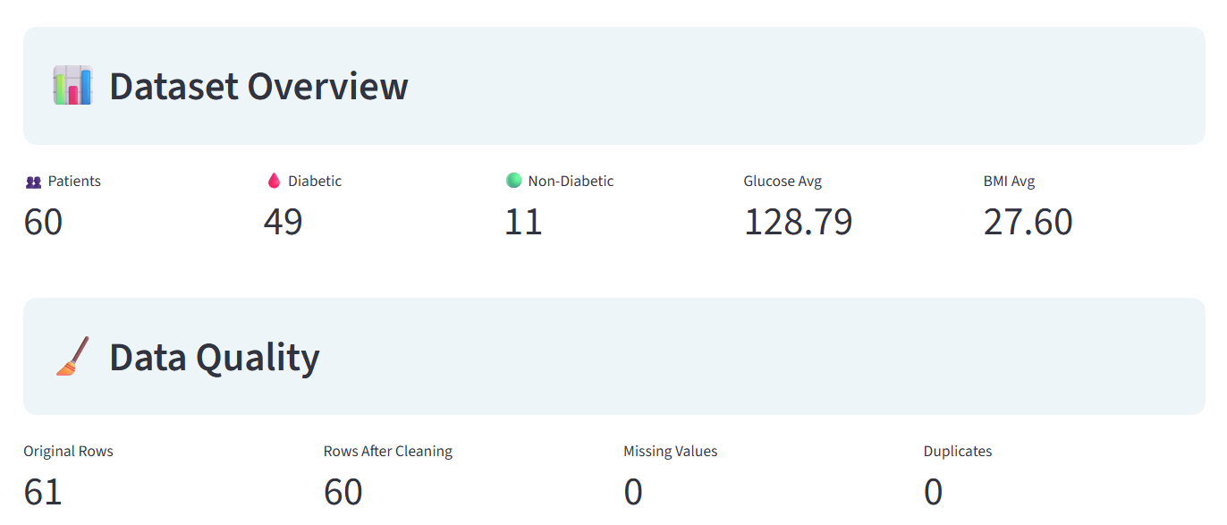
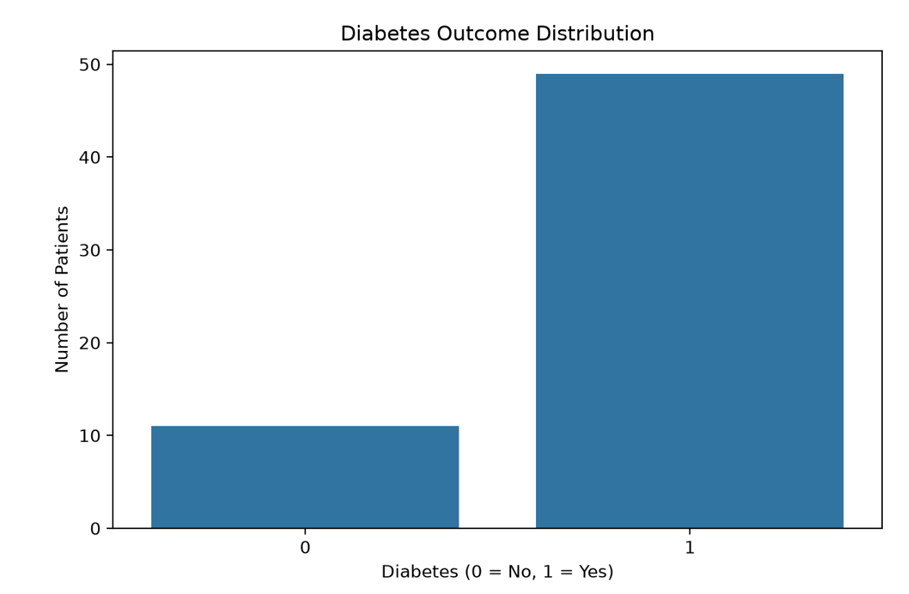
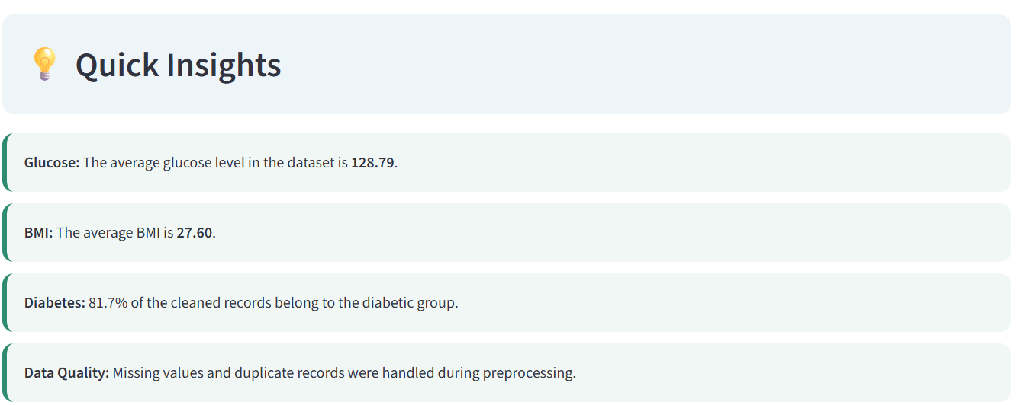
Dashboard
Diabetes Distribution

Slide 13
Results and Recommendations
Glucose and BMI showed important relationships with diabetes outcomes; regular glucose and BMI monitoring is recommended.
Age and blood pressure were identified as important healthcare factors; routine health check-ups can help in early risk identification.
Lifestyle factors such as physical activity and diet showed meaningful patterns; maintaining a balanced diet and regular exercise is recommended.
Data visualization and statistical analysis helped identify clear trends and relationships; these methods can support better healthcare decision-making.

Slide 14
Future scope
Extend the system to predict other chronic diseases such as heart disease and hypertension
Integrate real-time patient data from wearable health devices
Use deep learning techniques for improved prediction performance
Develop a mobile or web-based healthcare application
Implement personalized health recommendations based on patient risk levels

Slide 15
Conclusion
This project successfully explored diabetes risk factors using healthcare, lifestyle, and demographic data through data preprocessing, exploratory data analysis, statistical analysis, and data visualization. The analysis helped identify important patterns and relationships among factors such as glucose level, BMI, age, blood pressure, and lifestyle habits. The visualizations made the findings easier to understand and communicate. Overall, the proposed exploratory data analytics framework provides meaningful insights into diabetes risk factors and can support better health awareness, early identification of risks, and preventive decision-making.

Slide 16
References
International Diabetes Federation. (2023). IDF Diabetes Atlas, 10th Edition.
World Health Organization. (2024). Diabetes – Key Facts. World Health Organization
Centers for Disease Control and Prevention. (2024). National Diabetes Statistics Report. CDC Diabetes Resources
American Diabetes Association. (2024). Standards of Care in Diabetes. American Diabetes Association
International Diabetes Federation. (2025). Diabetes Atlas and Global Diabetes Data. International Diabetes Federation

Slide 17
THANK YOU!

